Slide 1
Advanced Leopard Seal Recognition System (ALSRS): Sprint 3
Bryce Robinson, Carson Buntin, Carsyn Smeda, Nathan Hontz, Juncheng Li, Ryan Huntington, Omar Darwish
Notes:
Carson

Slide 2
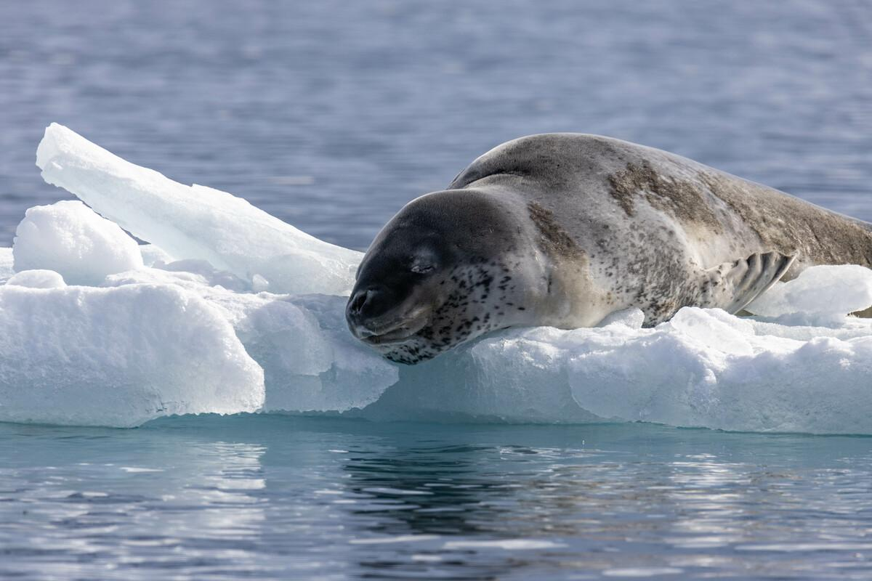
Project Review
Current lack of effective tools to detect and identify individual leopard seals
Develop API for Happywhale.com capable of receiving leopard seal photographs and returning the identity of any recognized seals
Utilization of two machine learning models for detection and identification of leopard seals
Notes:
Omar

Slide 3
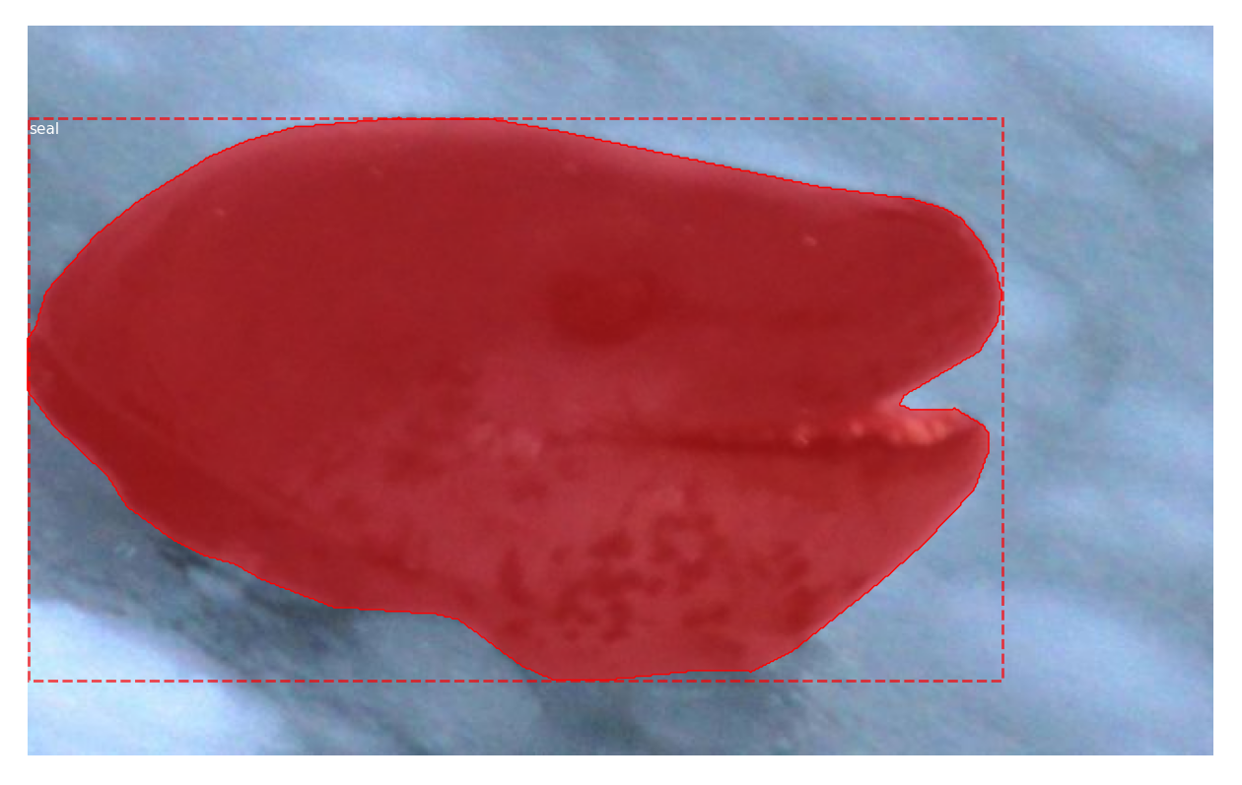
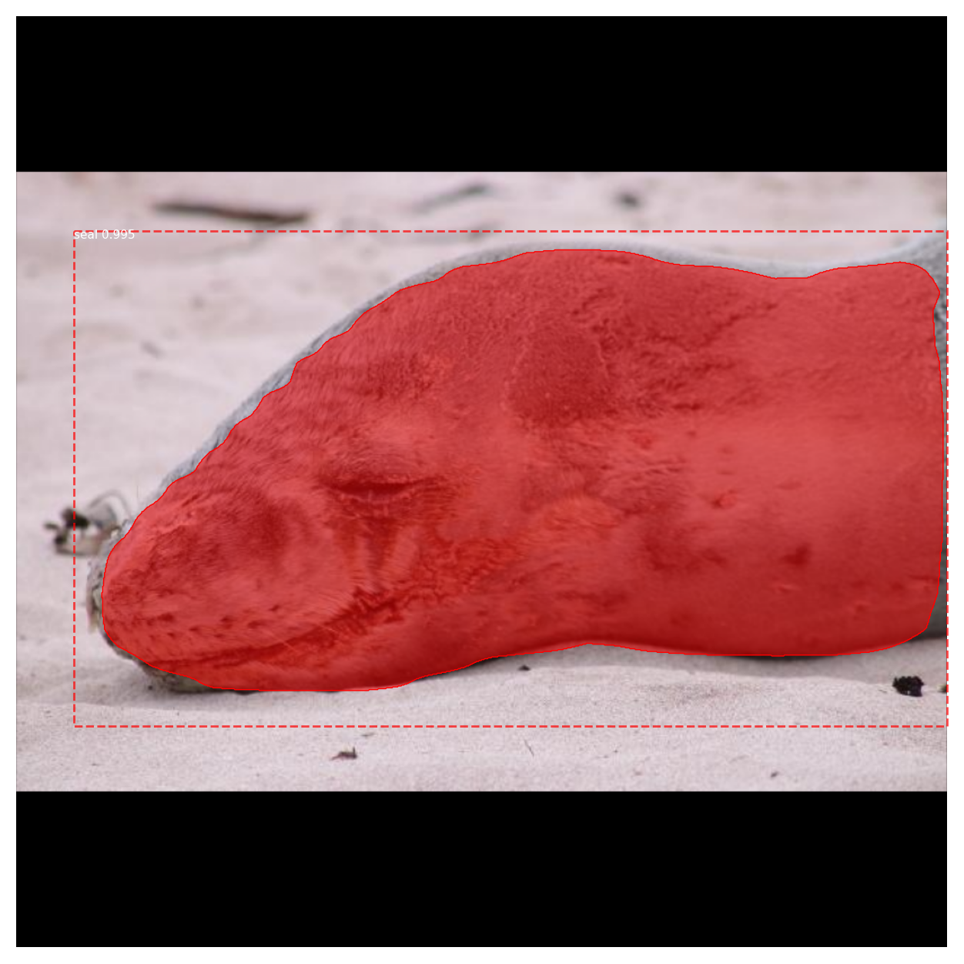
Mask RCNN Results
Need more negative data to improve detection of non-seals
Planning on combining coco dataset with our seal data
Notes:
Nathan

Slide 4
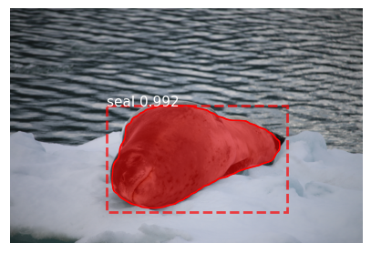
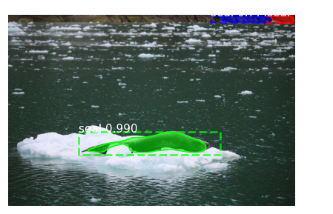
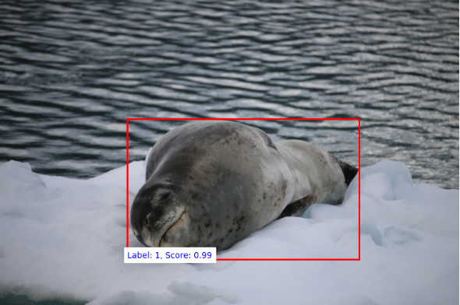
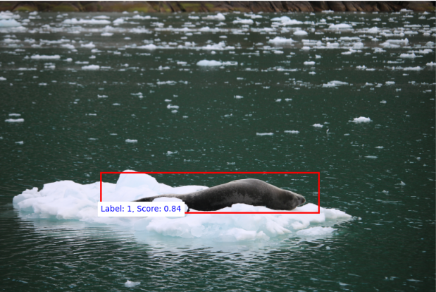
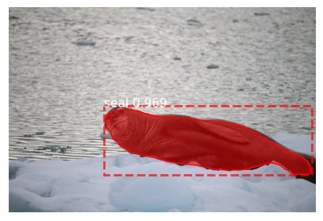
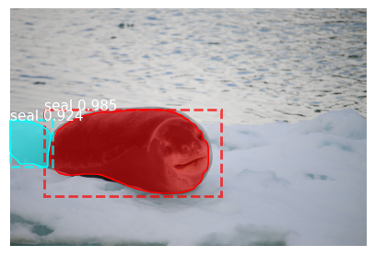
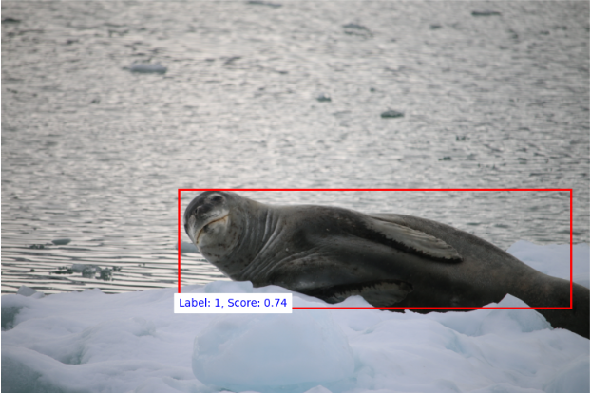
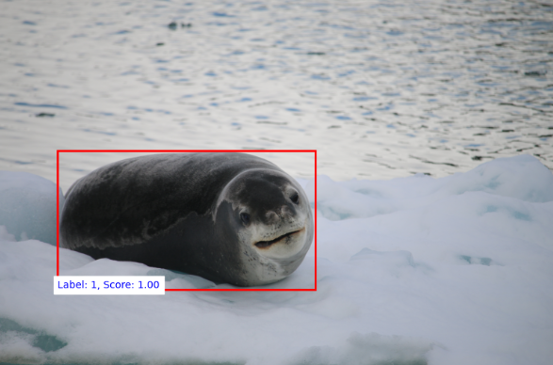
Detection Model Comparison
Mask RCNN
Faster RCNN
Notes:
Nathan and Juncheng

Slide 5
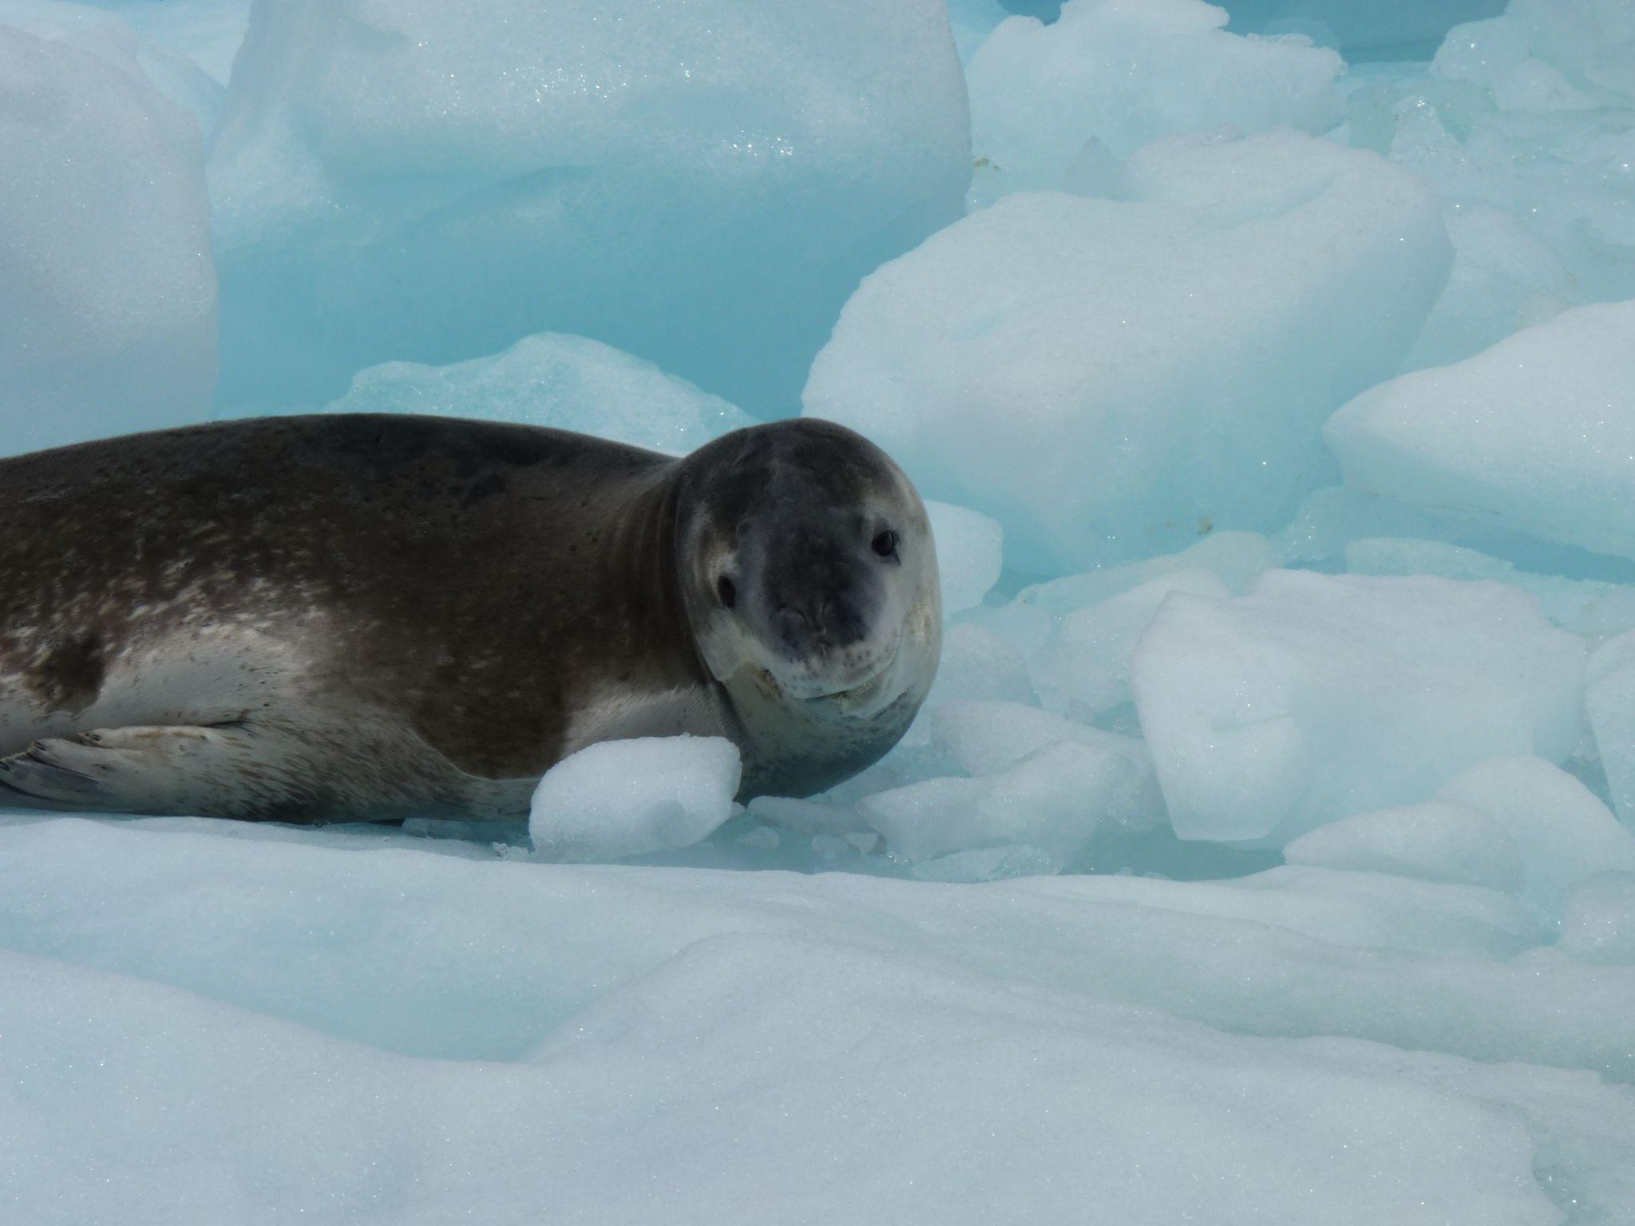
Identification Model: New Data
Project investigator allowed us access to a new dataset of identified seals and associated bounding boxes
Provides more data for identification model for more training, testing, and validation
Given dataset has 913 images, 13 individuals
Increased our corpus from 51 individual seals to 64 individuals
Notes:
Carsyn

Slide 6
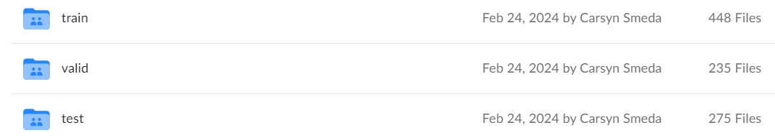
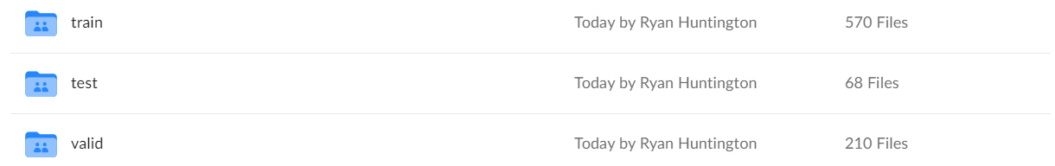
Cleaning Existing Dataset: Python Scripts
2 scripts used for preprocessing/cleaning:
Clean
Remove transparent portions of image
Rescale/resize 600x600
Reorganize
Force 70, 20, 10 split between train, valid, and test
1 image minimum between folders
Led to huge increase in accuracy
Notes:
Carson

Slide 7
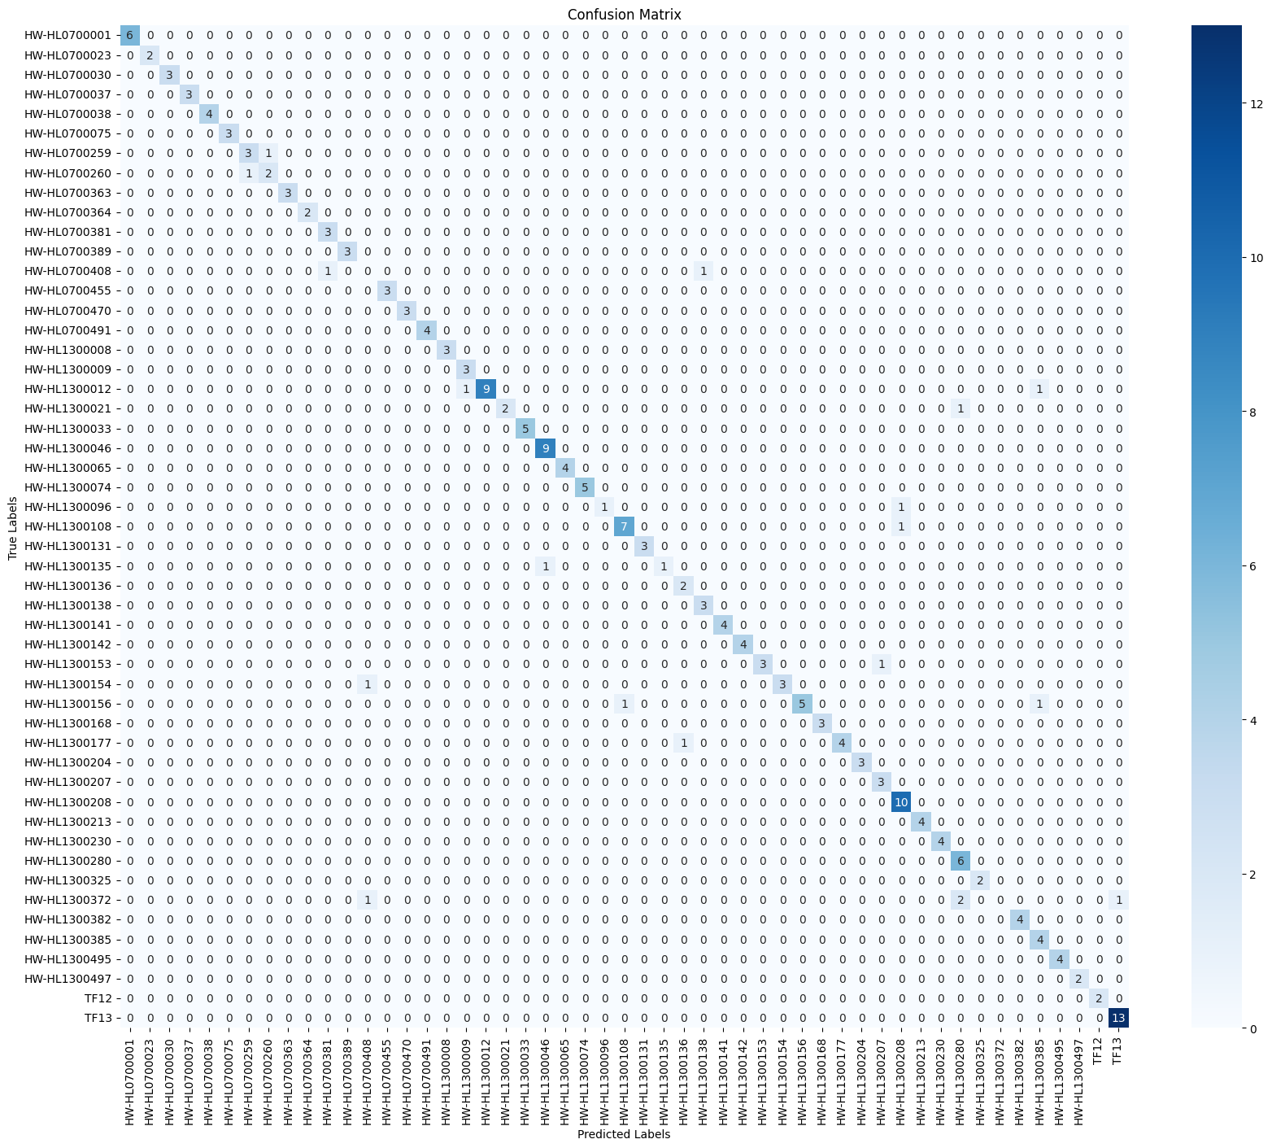
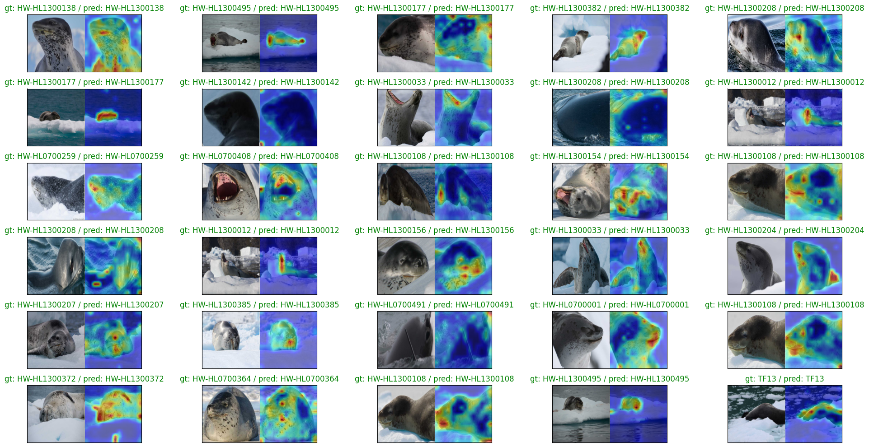
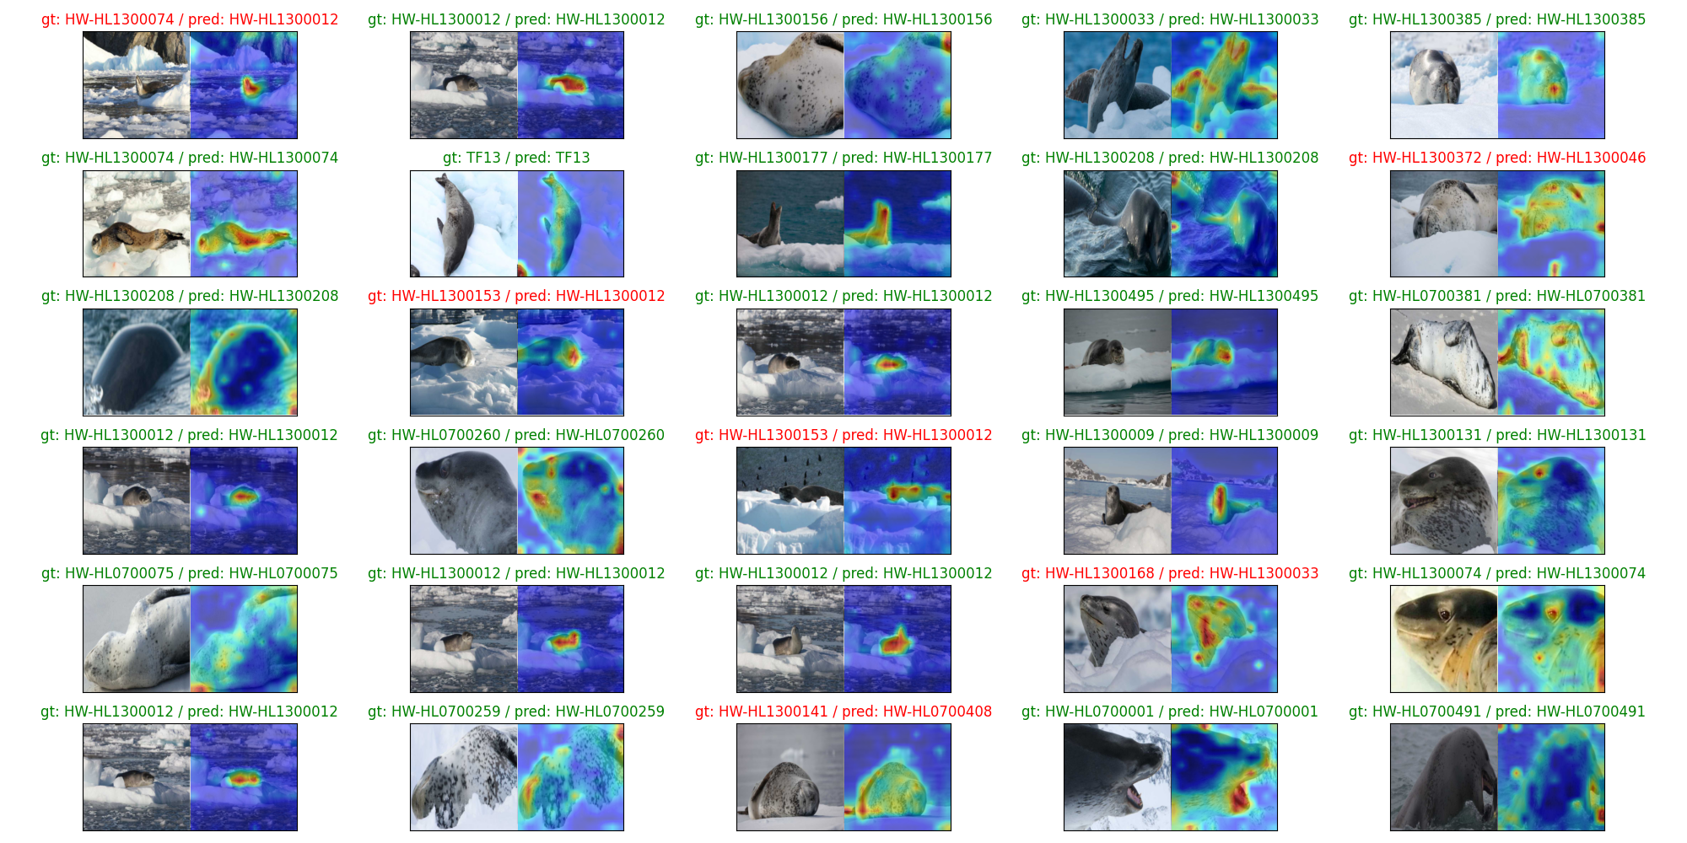
Continuation of DeiT
Augmentation of data
Tuning of hyperparameters
Attention Maps
Notes:
Ryan

Slide 8
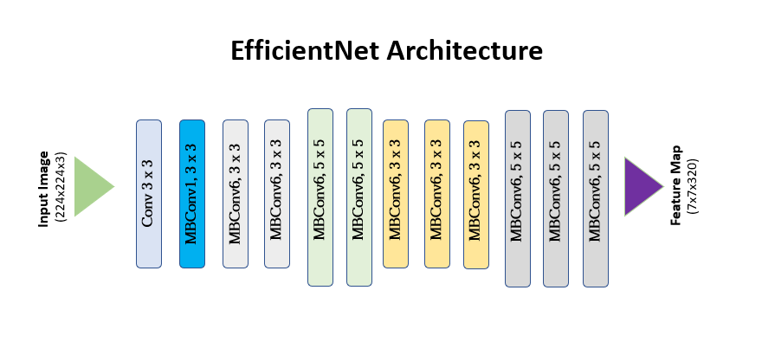
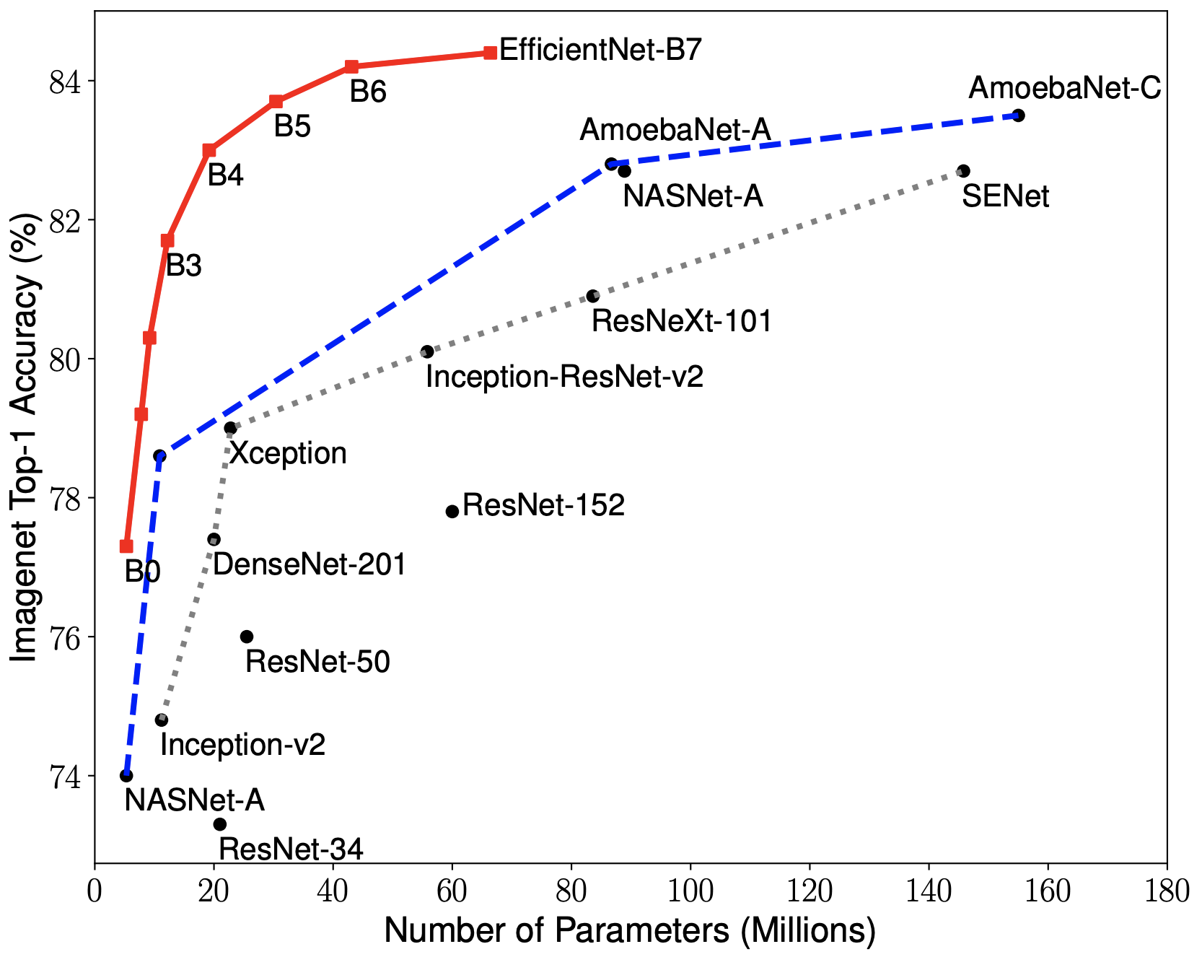
EfficientNet
Family of CNNs
Skilled in object recognition through compound scaling recognition
Notes:
Ryan

Slide 9
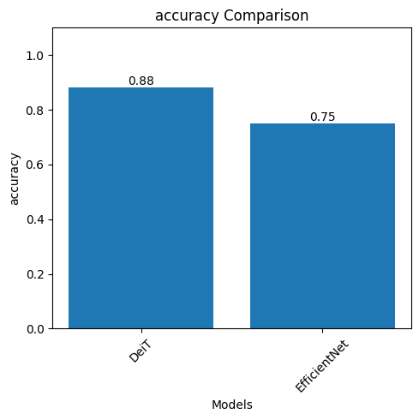
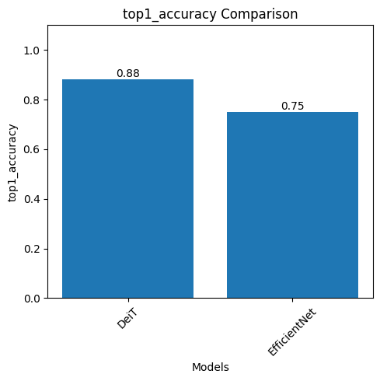
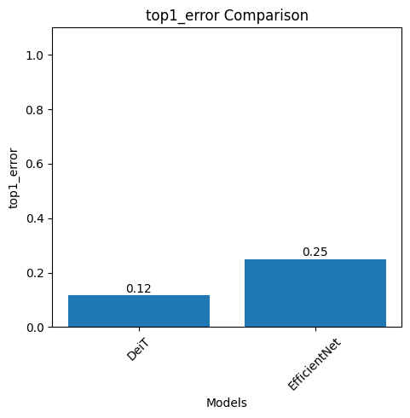
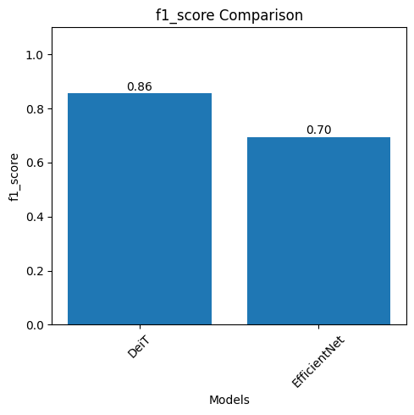
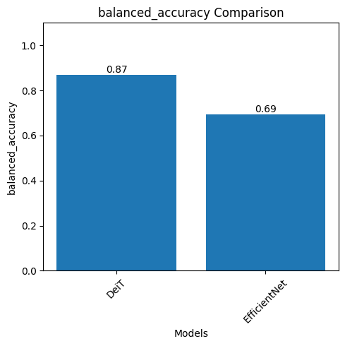
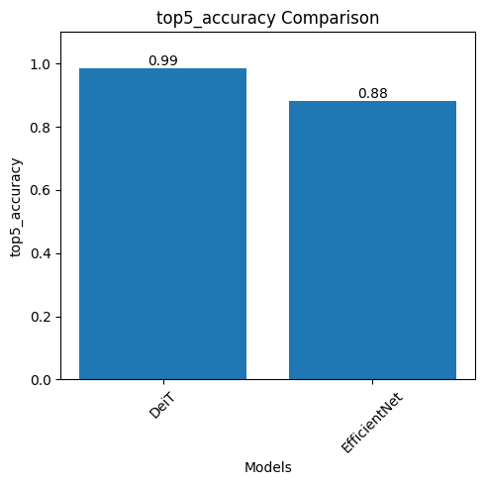
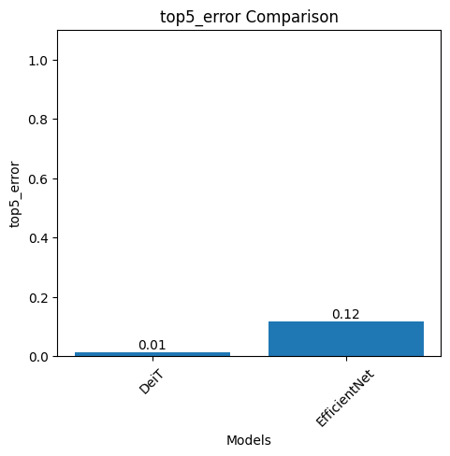
Metrics Comparison
Notes:
Ryan

Slide 10
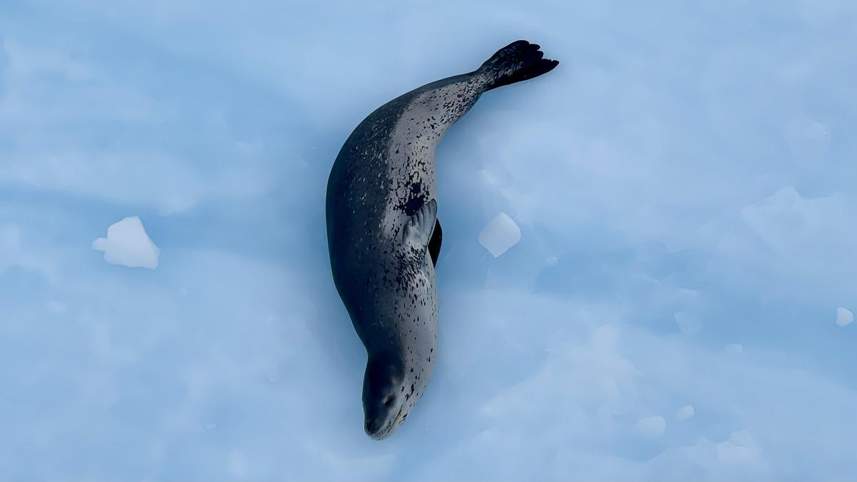
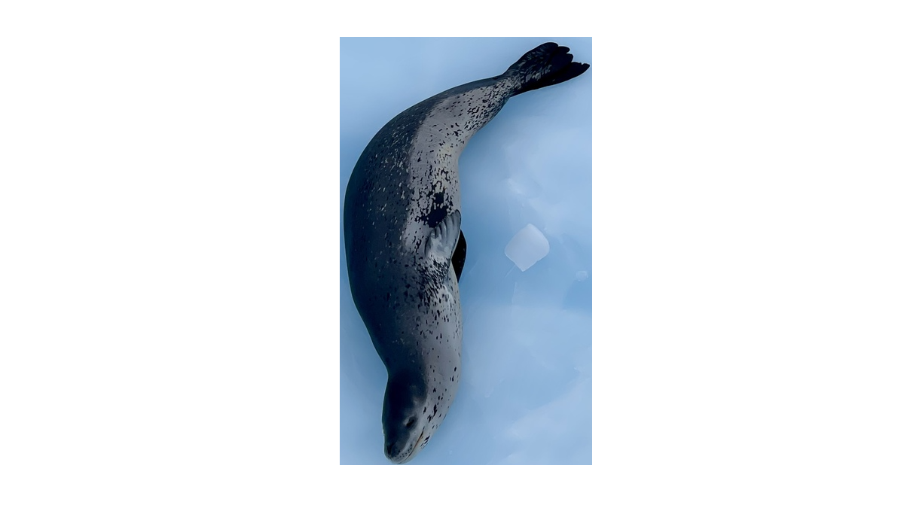
API Development
Still awaiting response from Happywhale about our API questions
DetectLeopardSeals
Endpoint to take a batch of images, feed them to an ML model, and return a set of bounding boxes for detected seals
Integrated external Python process for model using Java Process Builder
PreprocessImages
Endpoint to take a batch of images and bounding boxes, crop each one, and return the cropped images
Working to create unit tests to compare two cropped images
Notes:
Bryce and Carsyn

Slide 11
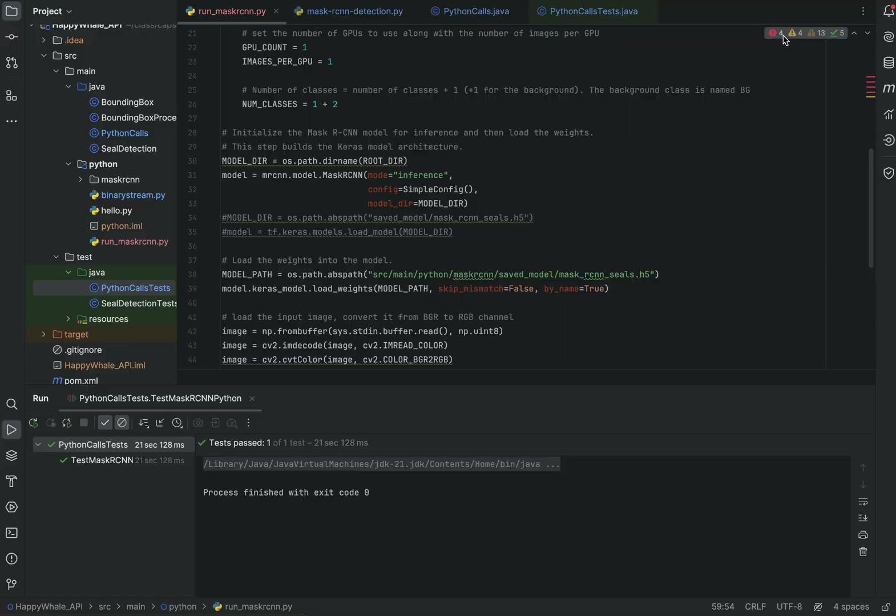
Running Model from Java (With JUnit5)
Notes:
Bryce

Slide 12
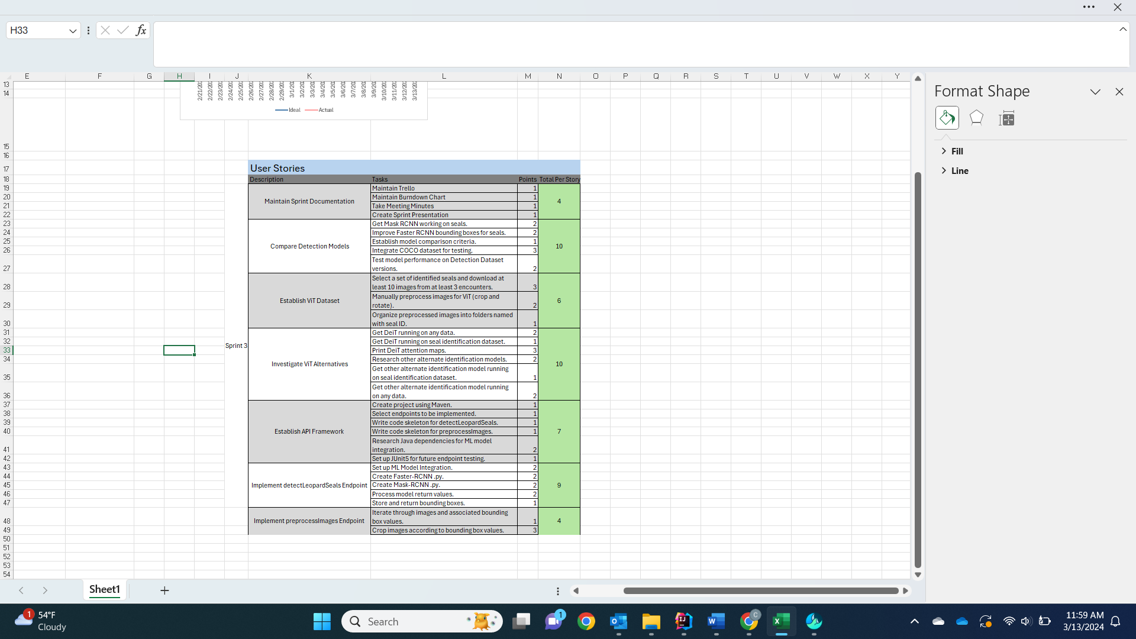
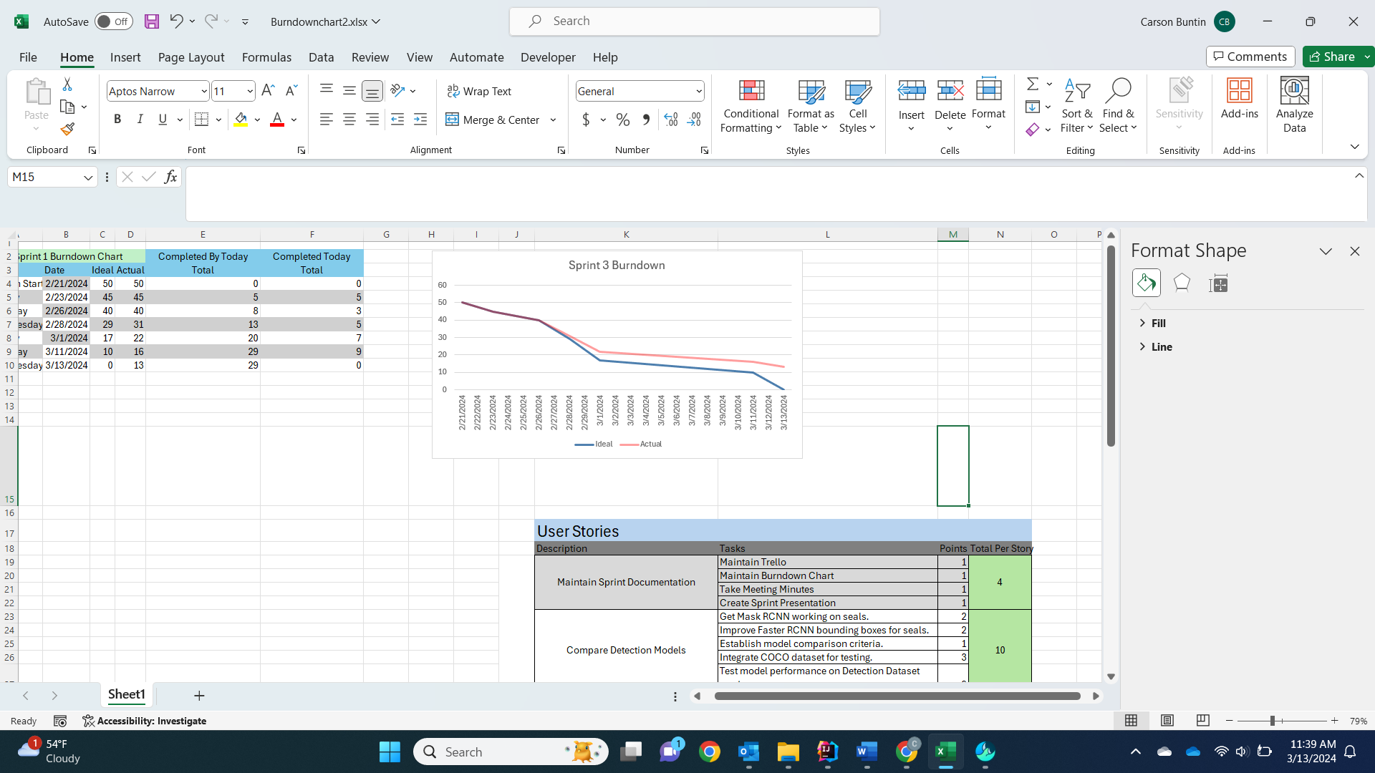
Burndown Chart and User Stories
Notes:
Carson

Slide 13
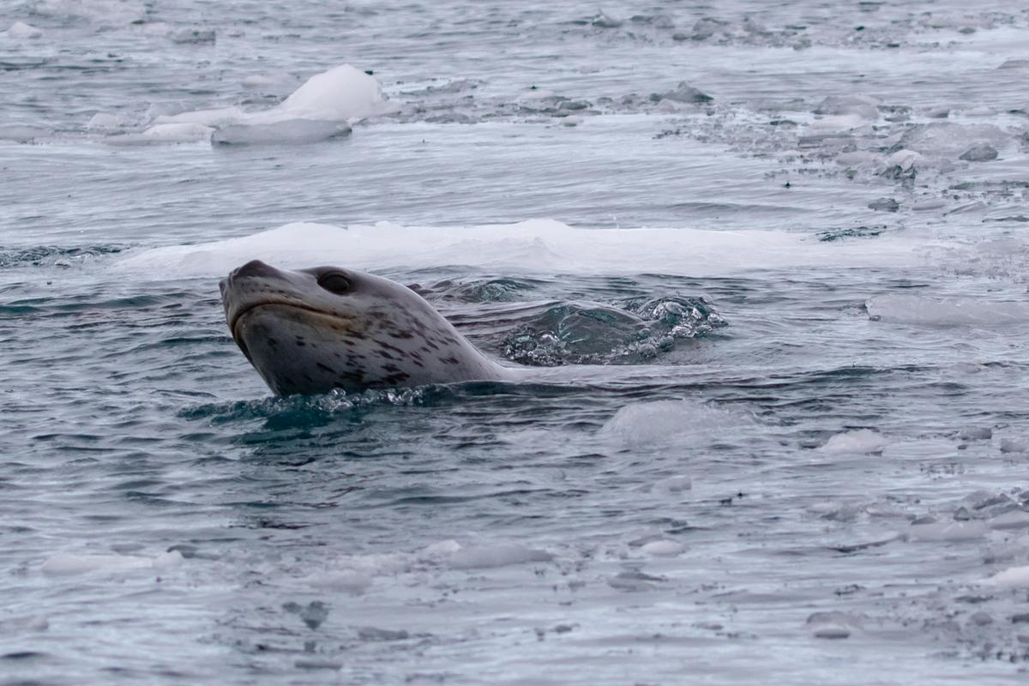
Next Sprint
Finalize model selections
Continue API integration of models
Implementation of further non-ML API endpoints
Combine provided data with our own datasets
Notes:
Bryce

Slide 14
Questions

